Slide 1
Embedded In-Vehicle Authorization (EiVA)
MEE308: I.E.M. Final Project
by
NIKHIL PANDITA
[ 14 BME 0133 ]

Slide 2
INTRODUCTION
Traditionally, vehicle security used to be all about keys and door locks. However in today’s digital age, it has become essential to incorporate high end technological solutions and advanced optimized computational techniques to ensure world class standards vehicle security and multi factor user authorization.

Slide 3
Problem Statement
In this paper, we aspire to address such vehicle security and user cognition procedures, validation & verification problems and describe an efficient and optimal strategy for vehicle-user pair recognition and secure switching over of shared vehicles without the hassles of physical keys.

Slide 4
Scope of the Project
The systems and methods utilize a pool of vehicles available for hire; at least one collection point at which the vehicles are issued; a central reservation system; and a system to verify user identify and reservation status wherein the system receives identifying information from a potential user, communicates the identifying information to the central reservation system which prompts the system to allow access to a reserved vehicle from the pool of vehicles available for hire in response to positive verification of the user and reservation status.

Slide 5
Bottomline
The main objective of this project was to integrate such a point-identity based security and authorization solution with top-of-the-class utility, convenience and rigidness in mind.

Slide 6
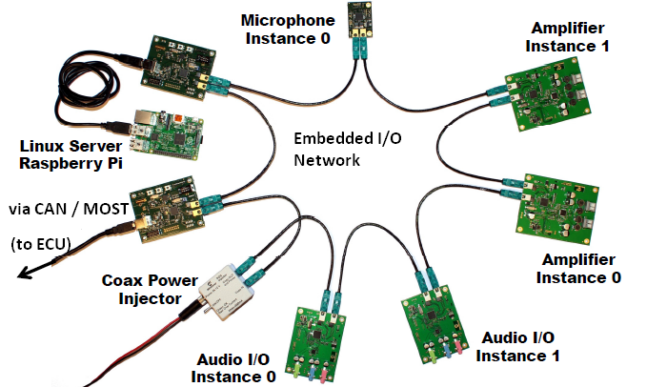
Methodology
The setup of recievers x transmitters over the main ECU.

Slide 7
Priorities
.
In our prototype, the ignition starts up from the instance a user inputs his fingerprint onto the embedded sensor in the vehicle dash.
A fingerprint Sensor is employed to additionally add to the security layers.
In the current prototype, fingerprint auth is provisionally provided by a smartphones’ in-built sensor

Slide 8
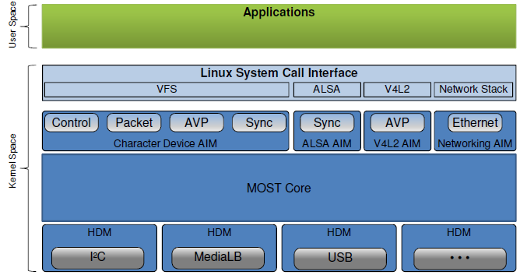
The following are the schematic reresentations of the AGLs hardware organization and internal architecture.

Slide 9
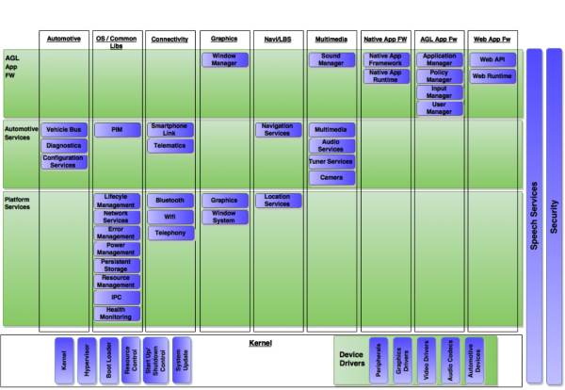
Architecture :

Slide 10
Results
(screenies)

Slide 11
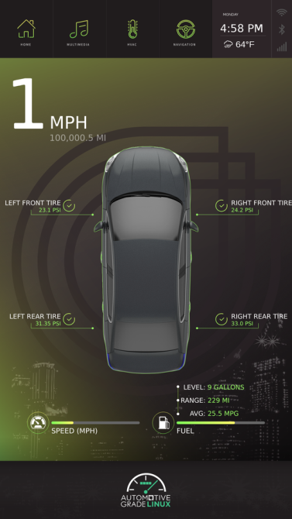

Slide 12
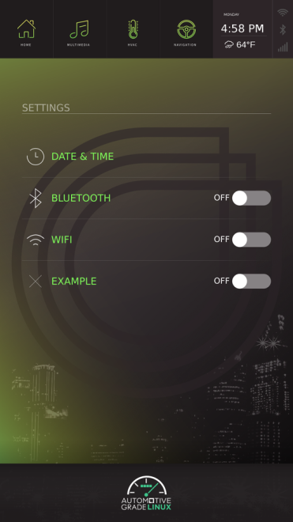

Slide 13
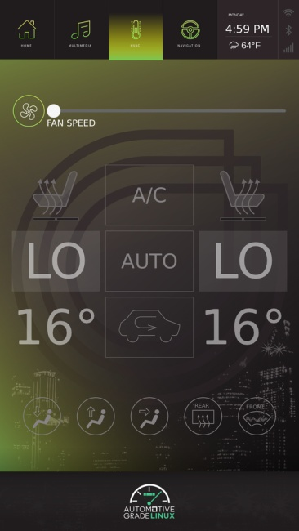

Slide 14
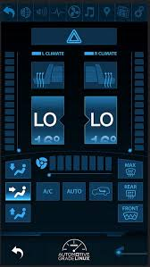

Slide 15
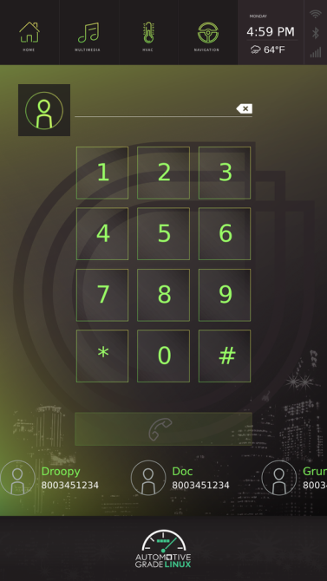

Slide 16
Conclusion
This is a promising project as further development is already ongoing in full swing within the AGL community and the EiVA. Next, Version 3.1, is expected to DEMO at the Tokyo CES, coming late this May, 2017.
Furthermore, I along with other AGL teams are continuously dedicated to the upkeep and maintenance of the unified AGL codebase round-the-year.

Slide 17
Staging, Downloading and Documentaton:
Source:
[ http://14BME0133.github.io/MEE308 ]
Mirror:
[ http://14BME0133.github.io/MEE218 ]

Slide 18






Acknowledgments
Further or any research done at all should be duly be accredited to the benevolence bestowed in kind by the following Organizations and Institutions:

Slide 19
References
The Car Hacker’s Handbook : A guide to automobile penetration testing Craig Smith, Chris Evans (http://www.sae.org/images/books/toc_pdfs/B981.pdf )
CAN specification version 2.0. Robert Bosch GmbH, Stuttgart, Germany, 1991
Homepage of the development partnership Automotive Open System Architecture (AUTOSAR): (http://www.autosar.org)
Getting started with Automotive-Grade Linux : (http://docs.automotivelinux.org)
Hardware and Communication Interfacing on a System-on-a-Chip (SoC: Pi 2.B+) (https://www.raspberrypi.org/documentation/hardware)

Slide 20
Thank you for validating this literature.
Nikhil Pandita
[ 14 BME 0133 ]

